Slide 1

6th Grade Accelerated Math
Unit 6, Lesson 13 Evaluating Exponents Volume 1, pg. 291

Slide 2


Benchmark
MA.6.NSO.3.3
Evaluate positive rational numbers and integers with natural number exponents.
volume 1, pg. 291

Slide 3
Integrated Mathematical Thinking and Reasoning Standards
MA.K12.MTR.4.1 Engage in discussions that reflect on the mathematical thinking of self and others.
MA.K12.MTR.5.1 Use patterns and structure to help understand and connect mathematical concepts.
volume 1, pg. 291

Slide 4

Learning Targets
I can evaluate integers with natural number exponents.
I can evaluate a positive rational number raised to a power.
volume 1, pg. 291

Slide 5

Warm-Up
volume 1, pg. 291

Slide 6
6.13.1 Warm-Up: Consider the YET
Consider the belief that “you can get better at whatever you want to get better at.” Explain whether you agree or disagree.
Consider the quote, “I’ve never heard of someone who took up running and didn’t get faster the more they did it.” That person just may not have been a fast runner … YET.
Complete the statement to describe something you want to
get better at.
I ___________________________________________ _______________________________________...YET!
volume 1, pg. 291

Slide 7

Exploration
volume 1, pg. 292

Slide 8

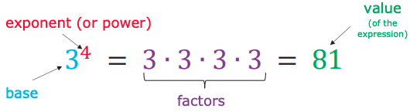

6.13.2 Exploration: Building on the Understanding of Exponents
Recall the vocabulary of exponential expressions.
Think of a number that will result in a value of 16 when it is raised to a power less than 6.
Write the base and its exponent.
volume 1, pg. 292

Slide 9

Compare your expression with your partner and check for accuracy.
If your partner found a different base and exponent that meets the description, write it below. If your partner wrote the same base and exponent as you, work together to find a second exponential expression that also works.
volume 1, pg. 292

Slide 10

With your partner, choose one of the exponential expressions used and rewrite it making the base negative.
Explain whether the negative base changes the value of the expression.
Discuss with your partner how you could change the exponent to result in a negative answer. Write a brief summary of your discussion below.
volume 1, pg. 292

Slide 11

Bring It Together
volume 1, pg. 293

Slide 12

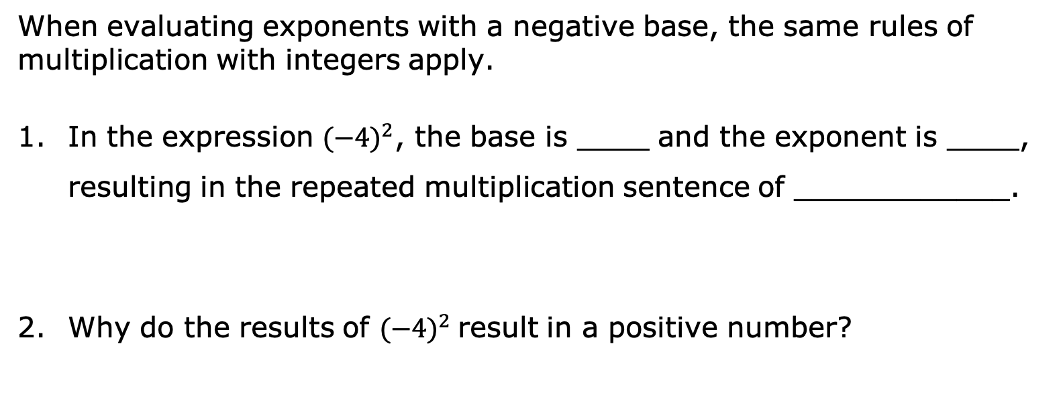
6.13.3 Bring It Together: Building on the Understanding of Exponents
When evaluating exponents with a negative base, the same rules of multiplication with integers apply.
In the expression ${\text{(−4)}}^{2}$, the base is ____ and the exponent is ____, resulting in the repeated multiplication sentence of ____________.
Why do the results of ${\text{(−4)}}^{2}$result in a positive number?
volume 1, pg. 293

Slide 13
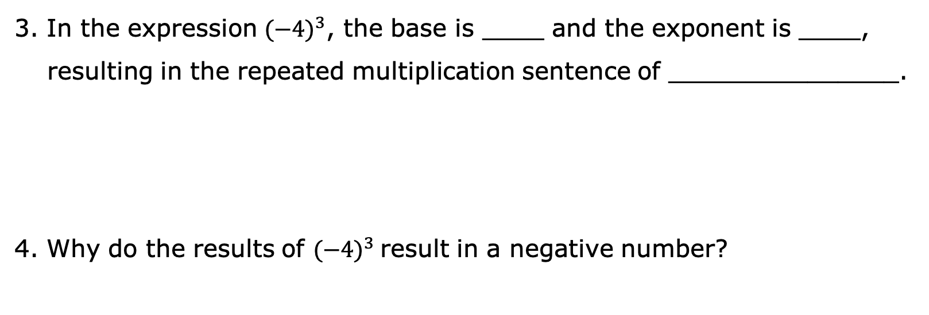
3. In the expression ${\text{(−4)}}^{3}$, the base is ____ and the exponent is ____, resulting in the repeated multiplication sentence of _______________.
4. Why do the results of ${\text{(−4)}}^{3}$result in a negative number?
volume 1, pg. 293

Slide 14
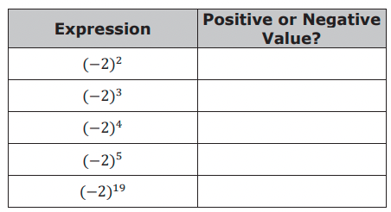
5. For each expression, determine whether its value is positive or negative.
volume 1, pg. 293

Slide 15
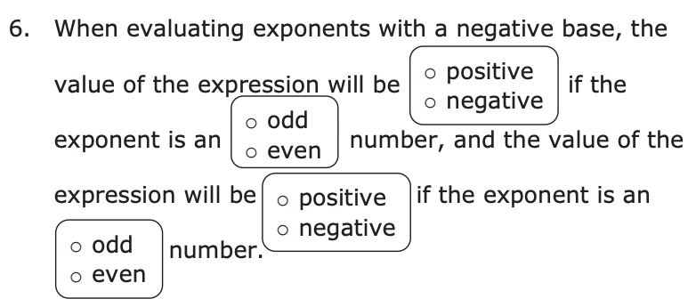
volume 1, pg. 293

Slide 16

Your Turn
volume 1, pg. 294

Slide 17
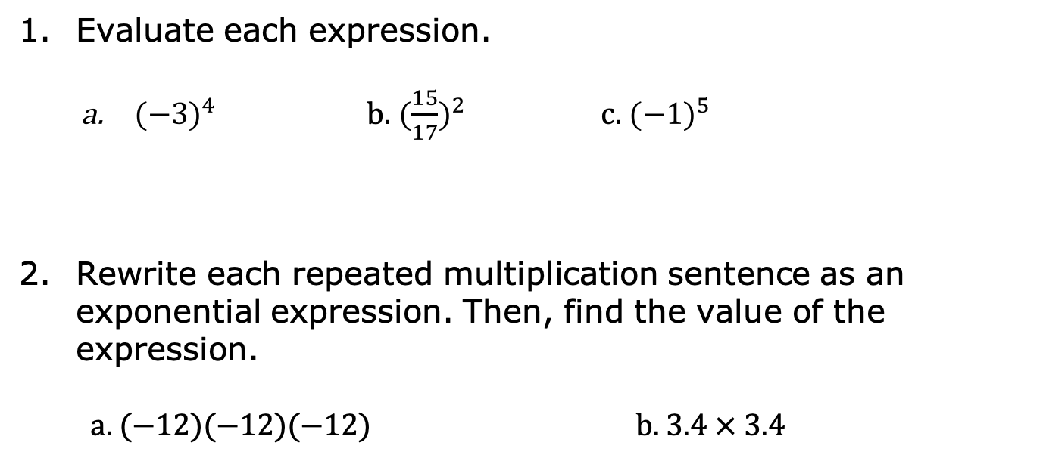
6.13.4 Your Turn!
Evaluate each expression.
${(−3)}^{4}$ b. ${(\frac{15}{17})}^{2}$ c. ${(−1)}^{5}$
Rewrite each repeated multiplication sentence as an exponential expression. Then, find the value of the expression.
a. (−12)(−12)(−12) b. 3.4 × 3.4
volume 1, pg. 294

Slide 18
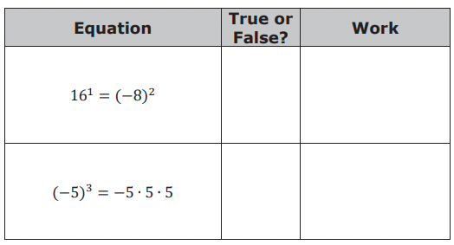
3. Determine if each equation in the table is true or false. Show your work to support your answer.
volume 1, pg. 294

Slide 19

Wrap-Up
volume 1, pg. 294

Slide 20
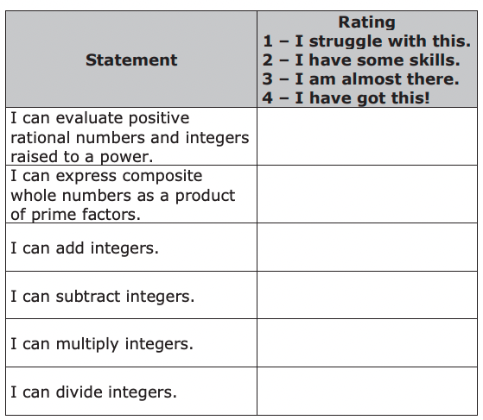
6.13.5 Wrap-Up: Reflection
1. In this unit, you have learned multiple concepts about operations with integers. Rate yourself on the following skills based on your level of understanding.
volume 1, pg. 294

